Slide 1



SES POLICY AND SCREENING UPDATE
THINGS YOU NEED TO KNOW
David Maier – SES Policy Specialist

Slide 2

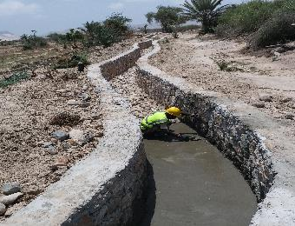
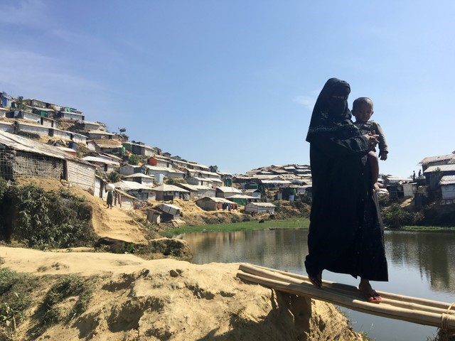
WHY?
WHAT?
HOW?
Ensure that environmental and social considerations are taken into account at the earliest possible moment. Conduct due diligence. Engage affected people.
Unintended harm to people and the environment undermines the goal of development.
Social and environmental safeguards (e.g. UNDP’s SES)

Slide 3
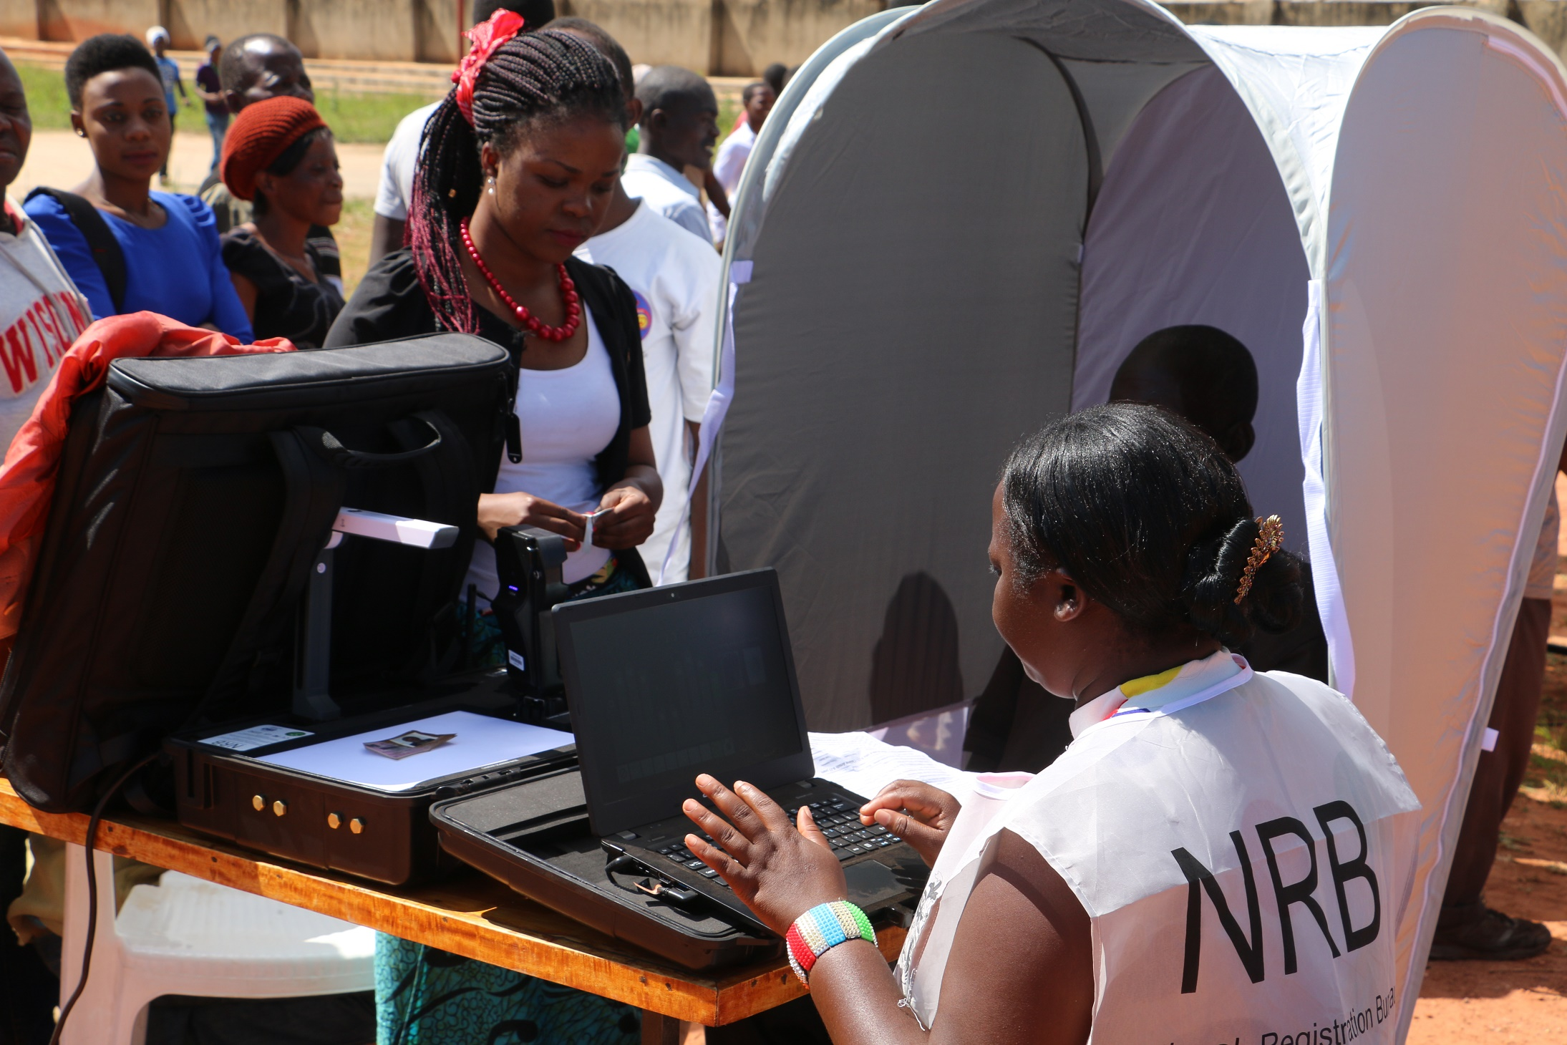


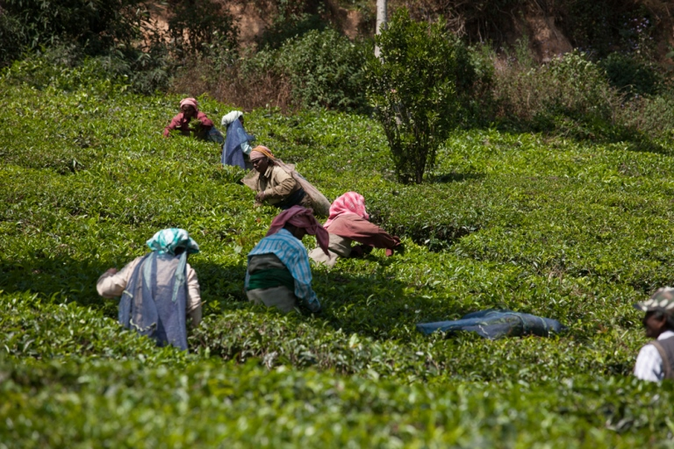
EXAMPLE GRIEVANCES INVESTIGATED BY OAI
(Social & Environmental Compliance Unit, SECU)
REGISTRATION OFFICERS CLAIM UNSAFE WORKING CONDITIONS AND INADEQUATE PAY
UNDP accused of human rights violations in the name of conservation
UNDP accused of greenwashing while Government destroys the environment
Community opposes UNDP initiative claiming they were excluded from process
Notes:
Even with good due diligence and risk management, things can still go wrong
Need a mechanism to respond and address grievances

Slide 4

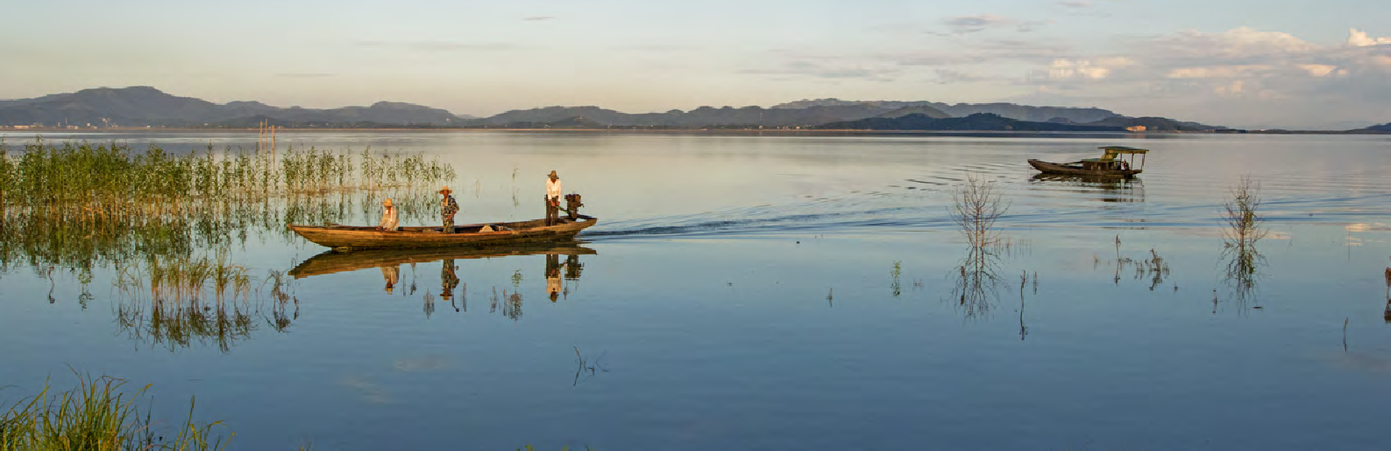
UNDP’s Social and Environmental Standards (SES) make a direct difference in the lives of our beneficiaries every day, in areas including:
STRENGTHENING SUSTAINABILITY AND RESILIENCE
PROTECTING HUMAN RIGHTS
PROMOTING GENDER EQUALITY & WOMEN’S EMPOWERMENT

Slide 5
SES Policy Update - Timeline
SES Policy Soft Launch: Start of Communications, Corporate Trainings, Guidance Materials.
Transition Period January 1st 2021 - December 31st 2021.
Approval of the Updated SES and SESP.
JANUARY 2015
JULY 2019
JULY 2020
EARLY DECEMBER 2020
JANUARY 1ST, 2021
2021
ONWARDS
Supporting implementation
Social and Environmental Standards first come into effect.
SES
Implementation Plan and Learning Strategy approved by the OPG.
Launch of the updated SES policy.

Slide 6

TRANSITION PERIOD
To facilitate a seamless changeover to the updated SES, a transition period has been introduced. Especially for projects that initiated their preparation process under the 2015 SES, a flexible approach may be required. For these cases the signature date of the Project Document will be the decisive factor in determining the applicability of the 2015 or 2021 SES Policy as shown below:
SIGNATURE BETWEEN 01 JAN 2015
– 31 DEC 2020
will be assessed for compliance against the 2015 SES policy.
If these projects undergo a substantive revision after 01 January 2021, they are required to apply the 2021 Social and Environmental Screening Procedure (SESP) that is aligned to the 2021 SES policy and will thereafter be assessed for compliance against the 2021 SES policy.
will be assessed for compliance against either the 2015 SES or the 2021 SES depending on which SESP is included in Annex to the signed Project Document.
Should this be the 2015 SESP this project will be assessed against the 2015 SES policy.
SIGNATURE BETWEEN 01 JAN 2021
– 31 DEC 2021
Should this be the 2021 SESP this project will be assessed against the 2021 SES policy.
Projects that are SESP exempt will be assessed for compliance against the policy that was in e"ect at the start of implementation.
will be assessed for compliance against the 2021 SES policy and will apply the 2021 SESP.
SIGNATURE ON/AFTER 01 JAN 2022

Slide 7


SES Policy Update - WHAT’S NEW?
Alignment with the new UN Sustainable
Development Cooperation Framework.
Provisions addressing
the rights of persons with disabilities.
Addition of a new Labour and Working Conditions Standard.
Provisions to strengthen disaster risk management.
Provisions addressing
risks of gender-based violence, sexual harassment and sexual exploitation and abuse.
Alignment with UNDP’s updated Programme and Project Management (PPM) and Enterprise Risk Management (ERM) policies.

Slide 8

SES Principles
Aligned with UN Cooperation Framework programming principles. the UN Cooperation Framework s
Human Rights
Gender Equality and Women empowerment
Sustainability and Resilience
Accountability
LEAVE NO ONE BEHIND
Maximise benefits
Avoid & Minimize E&S Impacts

Slide 9

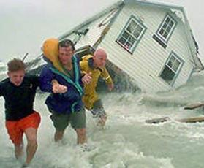
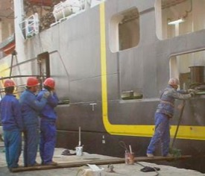
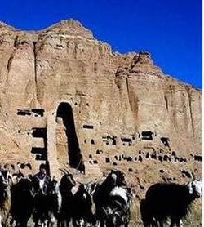
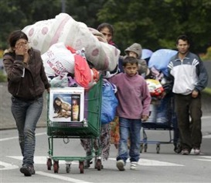
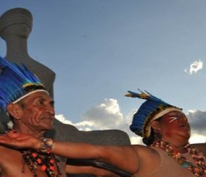
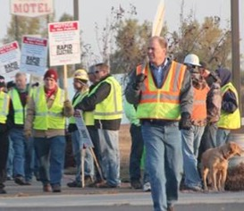
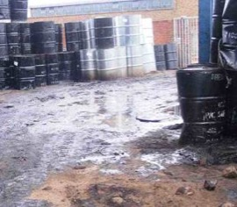
SES Project Level Standards
1
2
3
4
Biodiversity Conservation & Sustainable NR Management
Climate Change & Disaster Risks
Community Health, Safety & Security
Cultural Heritage
5
6
7
8
Displacement & Resettlement
Labour & Working Conditions
Pollution Prevention & Resource Efficiency
Indigenous Peoples

Slide 10






NEW STANDARD ON LABOUR & WORKING CONDITIONS
Assess risks to project workers and develop labour management measures.
Highlights workers’ fundamental rights, their fair treatment, and the provision of safe and healthy working conditions.
Ensures sound worker-management relationships and cooperation in their design and implementation.
Ensures applicable parties comply with employment and labour laws, rules and regulations and international commitments.
Prevents the use of child labour and forced labour.

Slide 11
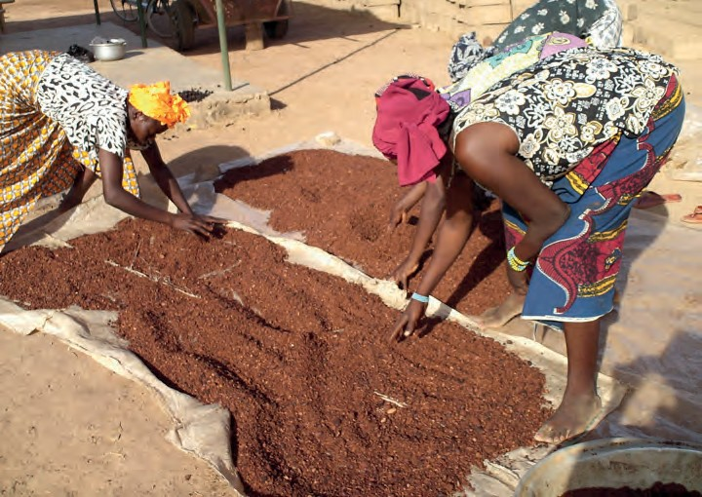
NEW RISK CATEGORY: SUBSTANTIAL
HIGH
SUBSTANTIAL
Projects with more varied/complex potential adverse social and environmental risks and impacts than Moderate Risk projects but which are more limited in scale and of lesser magnitude than those of High Risk projects (e.g. reversible, predictable, smaller footprint, less risk of cumulative impacts).
Scoped, fit-for-purpose Environmental and Social Impact Assessment & Plan (ESIA & ESMP) needed to analyze the range and interactions of potential risks and impacts.
For Substantial Risk projects that promote plans and policy reforms a scoped Strategic Environmental and Social Assessment (SESA) may be required.
MODERATE
LOW

Slide 12

Q & A
10 minutes

Slide 13

Grievance Mechanisms
An independent Compliance Review process to respond to claims that UNDP is not in compliance with applicable environmental and social requirements
Ensures people affected by projects have access to appropriate grievance resolution procedures for hearing and addressing project-related complaints and disputes
UNDP’s Accountability Mechanism
www.undp.org/secu-srm
Project Grievance Redress Mechanisms
Effectively address grievances from people impacted by projects, core component of managing risk and improving results.
Grievance redress mechanisms (GRMs) can be an effective tool for early identification, assessment, and resolution of concerns/issues.
Notes:
The Social and Environmental Standards are underpinned by an Accountability Mechanism with two key functions: 1) A Stakeholder Response Mechanism (SRM) that ensures individuals, peoples, and communities affected by UNDP projects have access to appropriate procedures for hearing and addressing project-related grievances; and 2) A Compliance Review process to respond to claims that UNDP is not in compliance with UNDP’s social and environmental policies.
- Here is a snapshot comparison of the Compliance Review and Stakeholder Response Mechanism
- They are both part of one system that offers two types of channels or options for stakeholders to share their concerns about the impacts of UNDP’s activities
- For both, any person or group of people affected by a UNDP project can file a complaint. A person and/or group can also file on behalf of a complainant that they represent.
- Complaints are made through the same mediums – a toll-free hotline, email, through the website or in person. The complaint will be channeled to either the compliance or SRM teams depending on the request made by the complainant.
- In terms of eligibility - complaints to compliance review must allege that UNDP is not in compliance w/its social and environmental commitments = SES, SESP
- In terms of who is responsible - the compliance review is housed and managed within the OAI and has its own unit. OAI was chosen because of its independence from management and OAI’s expertise in case management and effective investigation procedures.
- For the SRM - UNDP management is ultimately responsible. Responses are primarily led by CO focal points, as designated by the RRs. And in some cases, if requested by the complainant, by a HQ-based team, together w/the CO. SRM responses are also coordinated with Regional Bureaux and Regional Hub colleagues as relevant.
- With regard to Response Actions - For the Compliance side, OAI would lead an indep investigation into the claims made by the complainant and prepare a report of findings with recommendations for the Administrator's consideration and decision. For the SRM side, the response could include for example, a series of consultations, agreed changes to the project, or in more serious cases, independent mediation between conflicting parties.
- With regard to possible results from these two processes – there are range of possible outcomes on the compliance side with a focus on bringing the project back into compliance and if necessary, addressing any harm already caused by the project.
- In the case of an SRM process – the key issues raised by the complainant are either addressed through the response process or not. UNDP's commitment in the context of the SRM is to make our best effort to address the requests for support, while recognizing it is not always within our means to achieve a result that is satisfactory to all parties.

Slide 14

SUPPORTING IMPLEMENTATION/CO’s
Regional SES Strengthening Support through dedicated Action Plans.
Clarified SES roles, responsibilities and accountabilities throughout the organisation.
Expansion of SES Roster for external consultants.
Learning Strategy: Capacity Building, Webinars, Train-the-trainers, Communications Material.
•
SES Toolkit Update with expanded guidance materials and guidance notes.
New Guidance Note on Labour and Working Conditions.
•
Launch of the SES Online Screening Tool and Dashboard 2021.
Ensuring dedicated SES expertise in each of the Regional Bureaux (based in the Hubs), initially through LTA consultancies.

Slide 15
Learning Strategy – A closer look
Foundations Prior and alongside the launch of updated SES (2020/21)
Deliverables | Audience
Train a cadre of internal SES Experts who will have role in SES oversight and support | GPN staff primarily based in the regional hubs
Branding and Communications Materials | Communication materials (flyer, key messages), design of key knowledge products and materials
Webinars on policy updates and the basics | Foundational webinars for programming staff; targeted webinar sessions with RBx Country Oversight and Support Teams, RBx SES focal points
Updated guidance notes, tools and resources in the Toolkit and integrated in ThroughLine | Primarily for practitioners, accessible to all staff, partners, consultants

Slide 16
Learning Strategy – A closer look
Diversifying and Deepening Expanded and Deeper Learning Opportunities (2021-2022)
Deliverables | Audience
Continued trainings with GPN SES experts who have role in SES oversight and support, expanding specialized skills | GPN staff primarily based in the regional hubs
Mobilization of GPN experts to deliver trainings and support | Cadre of trained experts mobilized through GPN to provide trainings and support to COs, prioritizing high risk programmes/projects
Develop guidance/training on budgeting and costing for SES implementation in projects. | Primarily practitioners, open to all staff
Integration in induction trainings for all new staff | New staff
Facilitated peer-to-peer learning, thematic groups | Practitioners facing immediate and similar challenges
Integration in RBx, CoP meetings, and other workshops | Tailored to audience and objectives
Monthly webinar series in different languages (foundational, thematic, lessons learned) | Primarily practitioners, open to all staff
Continued development of the SES Toolkit and integration in ThroughLine | Primarily practitioners, open to all staff
Continued developed of communication and advocacy materials | Internal and external
“Bite-size” how-to videos on particular issues | Primarily practitioners, open to all staff, partners, consultants
Workshops and Targeted Trainings (identified based on priority capacity needs within regions) | Tailored to audience and objectives, the training and workshops will be focused primarily on high-risk countries and programs, with some flexibility to respond to priority needs/issues identified in discussion with RBx and oversight colleagues.

Slide 17





SES Resources
FOR MORE INFO:
SES TOOLKIT
UNDP SES WEBSITE

Slide 18


Slide 19
Q & A

